Slide 1


Computational Intelligence (TC2023)

Slide 2

Unit 2 – Security Data Analysis
Outline
What is Data Analysis?
Data Analysis Foundations
Data Summarization

Slide 3

What is Data Analysis?

Slide 4

What is Data Analysis?
Data analysis is a process of inspecting, cleansing, transforming, and modeling data with the goal of discovering useful information, informing conclusions, and supporting decision-making.

Slide 5
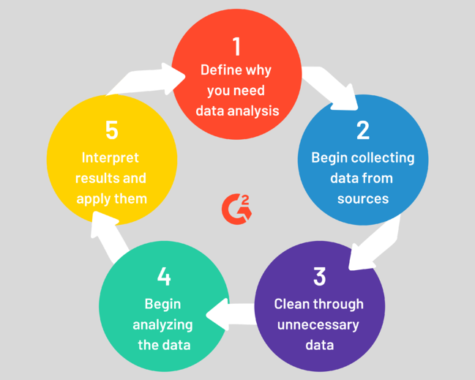
Data Analysis Process

Slide 6
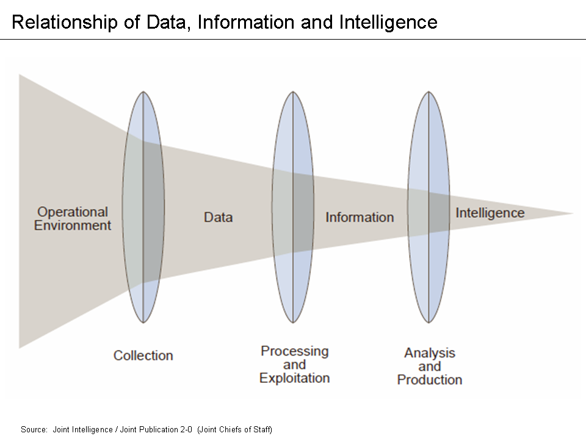
Data, Information, and Intelligence

Slide 7
Data Analysis Foundations
unit2_intro_data_analysis.py
conn_sample_header.log
conn_sample_noheader.log

Slide 8

Pandas (Python Data Analysis Library)
Pandas (Python Data Analysis Library) is an open source, BSD-licensed library providing high-performance, easy-to-use data structures and data analysis tools for the Python programming language.
Pandas provides data frame functionality for reading / accessing / manipulating data in memory.
Data frame is similar as a table of indexed values.

Slide 9
Import a CSV File
Define the separator = comma
import pandas as pd logfile_header = 'resources/conn_sample_header.log' #read the log file with header conn_df_header = pd.read_csv(logfile_header, sep=",")
Save in the memory the csv file

Slide 10

Import a CSV File
import pandas as pd conn_df = pd.read_csv(outfile, sep="\t", header=None, names=['ts','uid',’id_orig_h',’id_orig_p', ‘id_resp_h',’id_resp_p', 'proto','service','duration','orig_bytes','resp_bytes', 'conn_state','local_orig','missed_bytes’,'history’,
'orig_pkts','orig_ip_bytes','resp_pkts’, 'resp_ip_bytes', 'tunnel_parents','threat','sample'])
headers
Inform that dataset does not have header

Slide 11
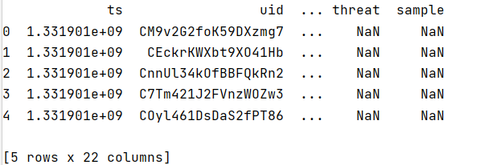
Understanding the dataset
#basic check of input,(values = head or tail) print(conn_df_header.head()) #shape of file print(conn_df_header.shape) #basic info of structure of dataset print(conn_df_header.info())
Show the five first lines in the dataset.

Slide 12
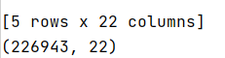
Understanding the dataset
#basic check of input,(values = head or tail) print(conn_df_header.head()) #shape of file print(conn_df_header.shape) #basic info of structure of dataset print(conn_df_header.info())
Show the basic information about the structure of dataset.

Slide 13
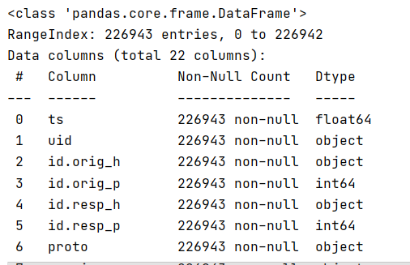
Understanding the dataset
Show the detail information about the header of dataset.
#basic check of input,(values = head or tail) print(conn_df_header.head()) #shape of file print(conn_df_header.shape) #basic info of structure of dataset print(conn_df_header.info())

Slide 14
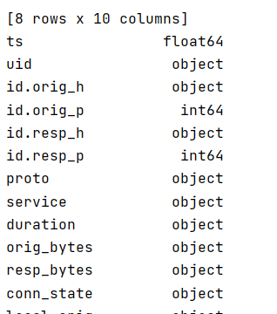
Understanding the dataset
#data types print(conn_df_header.dtypes)
#data sumarization print(conn_df_header.describe())
Another way to check the header information.

Slide 15
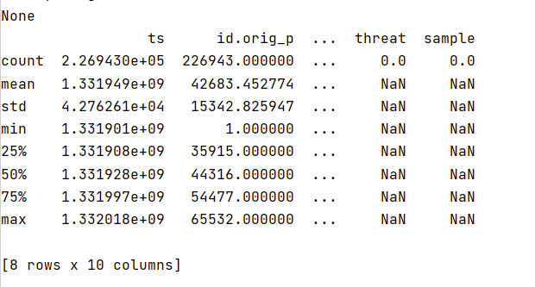
Understanding the dataset
#data types print(conn_df_header.dtypes)
#data sumarization print(conn_df_header.describe())
Show the basic statistic summary about the dataset.

Slide 16
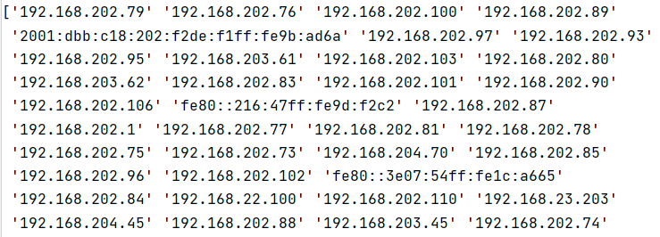
Pandas Basic Operations
#Return with the unique values of ‘id_orig_h' attribute. print(conn_df_header.id_orig_h.unique()) # or using this sintaxe -> print(conn_df_header['id_orig_h'].unique()) #count the instances print(conn_df_header.id_orig_h.value_counts())
Return with the unique values of ‘id_orig_h' attribute.

Slide 17
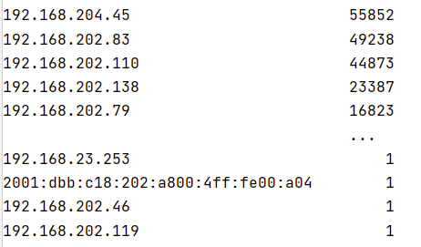
Pandas Basic Operations
#Return with the unique values of ‘id_orig_h' attribute. print(conn_df_header.id_orig_h.unique()) # or using this sintaxe -> print(conn_df_header['id_orig_h'].unique()) #count the instances print(conn_df_header.id_orig_h.value_counts())
Counts the number of instance each values has.

Slide 18
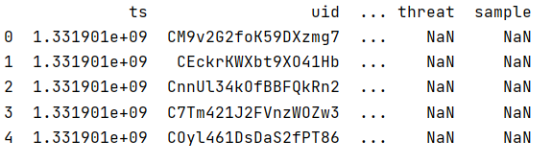
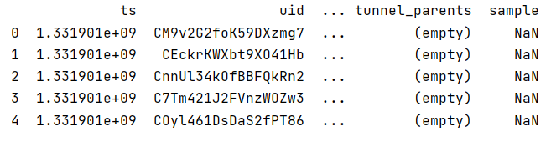
Pandas Basic Operations
#remove a column conn_df_header.drop('threat', axis=1, inplace=True) print(conn_df_header.dtypes)
Delete the column ‘threat’
Delete a line or column
axis: 0 (row); 1 (column)
inplace: Makes changes in original Data Frame if True.

Slide 19
Pandas Basic Operations
#drop two lines (0 and 2) print(conn_df_header.head()) conn_df_header.drop([0,2], axis=0,inplace=True) print(conn_df_header.head())
Delete the lines 0 and 2
Delete a line or column
axis: 0 (row); 1 (column)
inplace: Makes changes in original Data Frame if True.

Slide 20
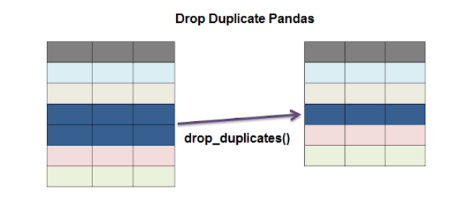
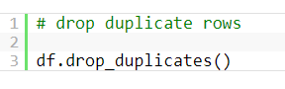
Pandas Basic Operations
Drop Duplicates lines

Slide 21


Pandas Basic Operations
Get the lines where service == ‘ssl’
#get the lines where the service is ssl #step 1 -> create a variable with TRUE where the condition is applied ssl_lines = conn_df_header.service=='ssl' #step 2 -> select in the frames, the lines where variables is true print(conn_df_header[ssl_lines])
Step 1 => Create variable with TRUE if service == ‘ssl’
Step 2 => Select all cases where the previous conditions is TRUE

Slide 22

Filtering Data (Loc x Iloc)
Loc: is label-based, which means that we must specify the name of the rows and columns that we need to filter out.
Iloc: is integer index-based. So here, we must specify rows and columns by their integer index.

Slide 23
Iloc
#get the first line print(conn_df_header.iloc[0]) #get a specific field in the first line srv = conn_df_header.iloc[0].service print(srv) #print all lines with field 2 (id_orig_h) print(conn_df_header.iloc[:,2]) #print the first three lines of field 2 print(conn_df_header.iloc[:3,2]) #'get line 1 to 3 (excluded line 1 and 3) of field 2 print(conn_df_header.iloc[1:3,2]) #'get line 1, 2 3 of field 2') print(conn_df_header.iloc[[1,2,3],2]) #get line 1, 2 3 of field 0 and 2 => ts & id_orig_p) print(conn_df_header.iloc[[1,2,3],[0,3]]) #('get the 5th last line') print(conn_df_header.iloc[-5])
is primarily integer position based (from 0 to length-1 of the axis) but may also be used with a Boolean array.
Allowed inputs are:
An integer, e.g. 5.
A list or array of integers, e.g. [4, 3, 0].
A slice object with ints, e.g. 1:7.
A boolean array.

Slide 24
loc
is primarily label based but may also be used with a boolean array.
Allowed inputs are:
A single label, e.g. 5 or 'a', (note that 5 is interpreted as a label of the index, and never as an integer position along the index).
A list or array of labels, e.g. ['a', 'b', 'c'].
A slice object with labels, e.g. 'a':'f’.
boolean array of the same length as the axis being sliced, e.g. [True, False, True].
An alignable boolean Series. The index of the key will be aligned before masking.
An alignable Index. The Index of the returned selection will be the input.

Slide 25
loc
########### loc ################ #'get the id_orig_h in the first line ') print(conn_df_header.loc[:0,'id_orig_h']) #'get all information from the fields above') print(conn_df_header.loc[:, ['ts','uid','id_orig_h','id_orig_p']])

Slide 26
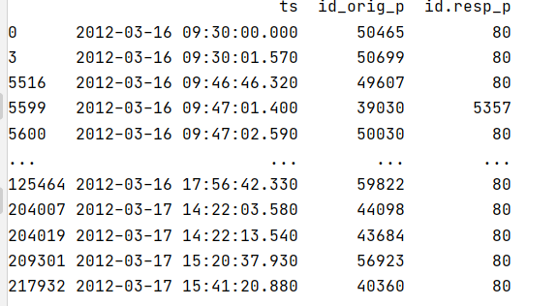
Advanced Operations with loc & iloc
print('return the values with complex condition assessment') values = conn_df_header.loc[(conn_df_header.service=='http') &
(conn_df_header.id_orig_h=='192.168.202.79')] print(values.iloc[:,[0,3,5]]) # only the fields [ts id_orig_p id_resp_p]
Define a complex string as the query’s return
Using iloc to return the attributes 0, 3, and 5 (all lines)

Slide 27
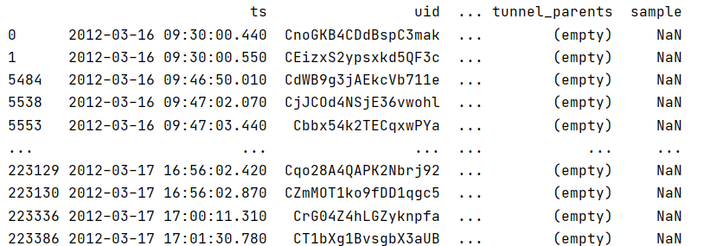
Advanced Operations with loc & iloc
print('return the values when the condition is true') print(conn_df_header.loc[conn_df_header=='http'])

Slide 28
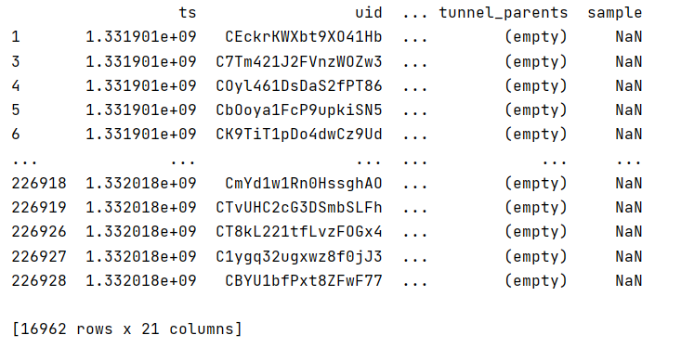
Advanced Operations with loc & iloc
Get the informations that contains elements of the blacklist
print('return the values inside the set') blacklist = set(['192.168.202.79', '192.168.202.85']) blacklist_values = conn_df_header.id_orig_h.isin(blacklist) print(conn_df_header[blacklist_values])

Slide 29

Let’s training?
Exercise 1 – IDPS Log Analysis

Slide 30

Data Summarization
unit2_summarization.py
http.log

Slide 31
Time Information in Network Analysis
Everything happening on the network is time sensitive.
This feature can not only prevent and analyze cyberattacks, but it can also allow you to examine trends and network latency.
Network packet timestamping can be used to investigate various events that, one way or another, have affected your network performance.
For instance, tracing the arrival of packets gives you an idea about the original traffic, so that you can calculate perlink metrics, like utilization figures, or performance of applications, such as TCP flow throughput, delay, and jitter.
Incorrectly timed packets will cause a delay in identifying and resolving the issues, which makes timestamping essential.
Timestamp in distributed sensors network can be used to correlate events.

Slide 32

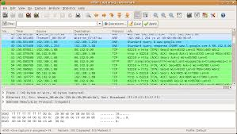
PCAP
PCAP (packet capture) is an application programming interface (API) for capturing network traffic.
Wireshark is a free and open-source packet analyzer. It is used for network troubleshooting, analysis, software and communications protocol development, and education.
Wireshark supports a bunch of export formats, including pcap.
Wireshark has a set of features that simplifies the analysis of a specific stream of data, having protocols plugins that enable analyst to read the information contextualized with the protocol.

Slide 33

Understanding the Dataset (http.log)
The data was generated from various PCAPs that have been collected and contain both legitimate traffic as well as traffic relating to exploit kits.
While no malicious traffic is contained within the log file there are malicious domains and URLS (it's recommended you don't visit them).
While this traffic was generated by running Bro over a series of PCAPS, similar data can be obtained from various Web Proxies, this is a nice cross over example of what is possible with your own data.

Slide 34

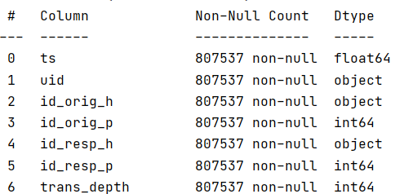
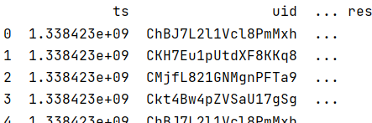
Convert to Datetime type
The timestamp is float.
To be possible to make time-series analysis, it is required to adjust the type to datetime.
print(http_df.info()) print(http_df.head())

Slide 35
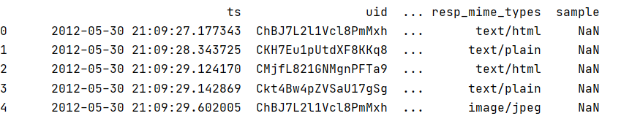
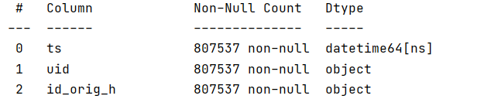
Convert to Datetime type
from datetime import datetime http_df['ts'] = [ datetime.fromtimestamp(float(date)) for date in http_df['ts'].values ] print(http_df) print(http_df.info())

Slide 36
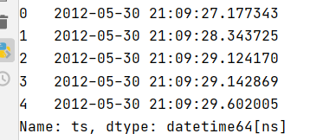
Resampling
Analyzing the dataset, perceives that it is indexed by the row number.
To perform time series analyzes, it is required that dataset is indexed by the timestamp.

Slide 37
Resampling
Index dataset by ts
http_df = http_df.set_index('ts') http_df.index = pd.to_datetime(http_df.index) http_df = http_df.sort_index() print(http_df.head())
Set index to type of 'DatetimeIndex',
Re-sort the dataset

Slide 38
Time Series Analysis
Perceive the timestamp field (ts) has a float type.
During a time-series analysis, the first task is looking for information in the dataset, trying to reassemble slice times of unusual or dangerous activities.

Slide 39
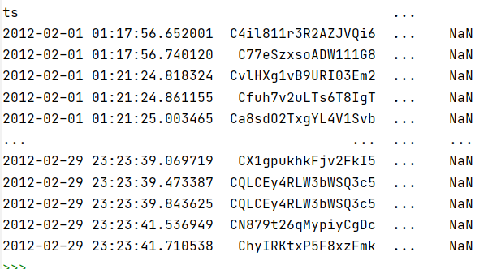
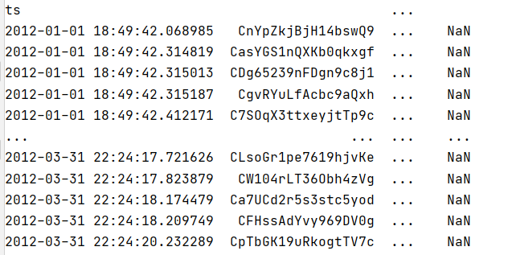
Perform queries
print(http_df['2012-02']) # select the given month print(http_df['2012-01':'2012-03']) # select between dates

Slide 40
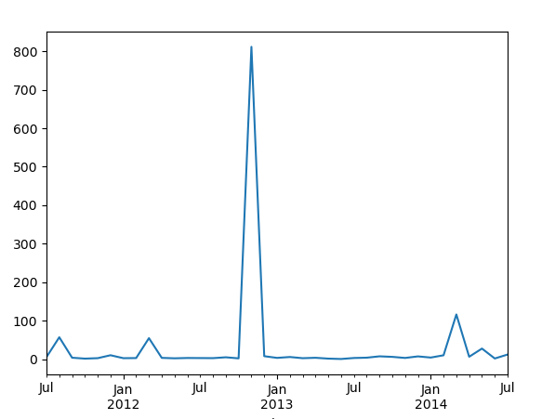
Resampling data
Resample ‘request_body_len’ attribute by month
Using matplotlib
import matplotlib.pyplot as plt conn_df_no_header.request_body_len.resample('M').mean().plot() plt.show()

Slide 41
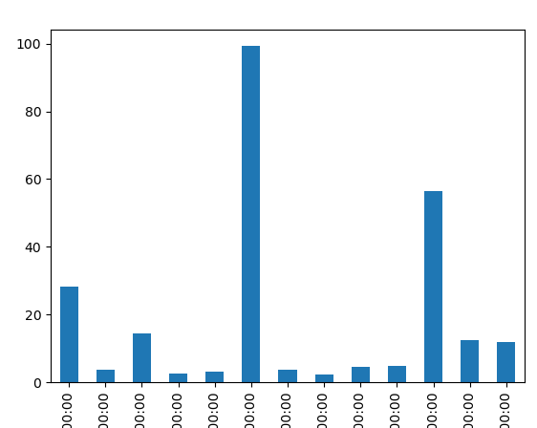
Resampling data
conn_df_no_header.request_body_len.resample('Q').mean().plot(kind='bar') plt.show()
line
area
bar
barh
pie
box
hexbin
hist
kde
density
scatter
Other kind of parameter
Notes:
https://towardsdatascience.com/an-ultimate-guide-to-time-series-analysis-in-pandas-76a0433621f3

Slide 42
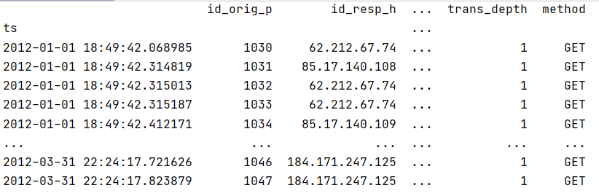
Resampling data
from datetime import date ts_dthr1 = pd.Timestamp(date(2012,1,1)) ts_dthr2= pd.Timestamp(date(2012,4,1)) values = http_df.loc[(http_df.index>ts_dthr1) &(http_df.index<ts_dthr2)]
print(values[http_df.columns.tolist()[2:7]])
Define two dates (datetime type)
Search the dates in the interval
Print only the columns 2 to 7
Notes:
https://towardsdatascience.com/an-ultimate-guide-to-time-series-analysis-in-pandas-76a0433621f3

Slide 43
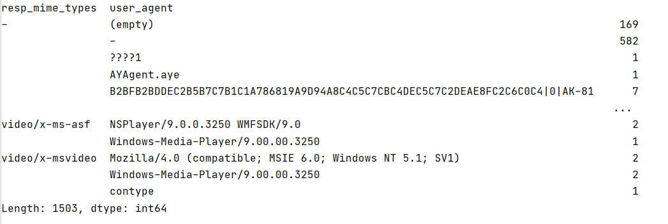
Grouping Data
Group the data base in some restriction passed by the user.
how many entries are in the data per-user-agent per-filetype.
print(http_df.groupby(['resp_mime_types','user_agent']).size())

Slide 44
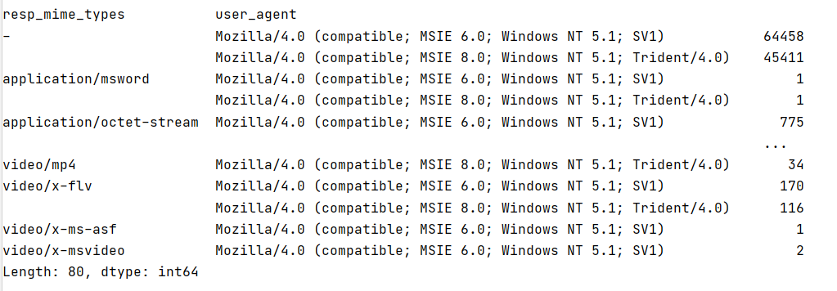
Using the isin function
Check if exist any values in the ‘user_agent’ field that is inside the set passed by the user (parameters).
After it group the information to present to the user.
print(http_df[http_df['user_agent'].isin( ['Mozilla/4.0 (compatible; MSIE 6.0; Windows NT 5.1; SV1)', 'Mozilla/4.0 (compatible; MSIE 8.0; Windows NT 5.1; Trident/4.0)'])].groupby(['resp_mime_types','user_agent']).size())

Slide 45
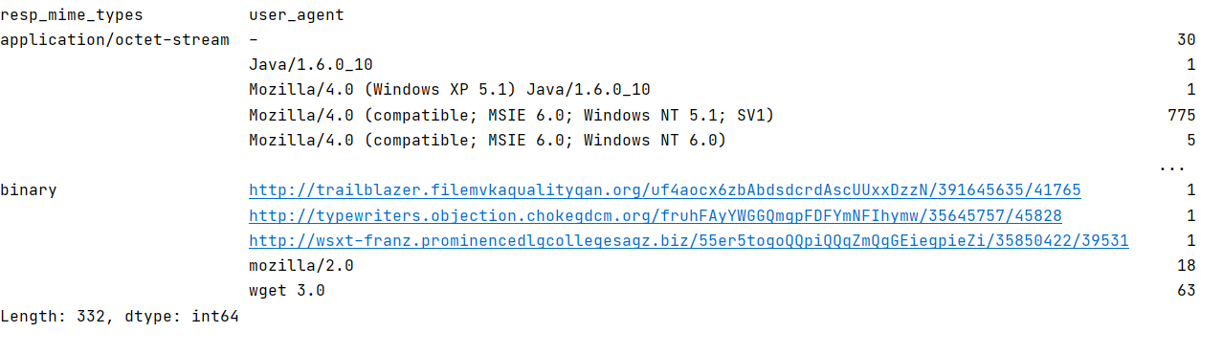
Using the isin function
executable_types = set(['application/x-dosexec', 'application/octet-stream', 'binary', 'application/vnd.ms-cab-compressed']) common_exploit_types = set(['application/x-java-applet','application/pdf','application/zip','application/jar','application/x-shockwave-flash']) print(http_df[http_df['resp_mime_types'].isin(executable_types)].groupby(['resp_mime_types','user_agent']).size())
Define a set of values to be used in the search using isin function

Slide 46
Unit 2 – Security Data Analysis
Outline
What is Data Analysis?
Data Analysis Foundations
Data Summarization

Slide 47
Computational Intelligence (TC2023)

